Slide 1
HOM – Project Management Module

Slide 2
Introduction
The time management function of HOM allows the user to analyze the process required to complete a time dependent project such as
New product introduction campaign
A consulting or accounting engagement
Software development

Slide 3
Introduction(2)
The key questions a manager might want to answer are
What is the shortest time it will take me to complete the project?
Can I save time if I invest financial resources, and where should I invest financial resources, and when should this be done?
If I’m not certain of exactly how long a task will take, can I determine the likelihood of the project taking a fixed amount of time?

Slide 4
Introduction(3)
The key to being able to answer the above questions depends on the user’s ability to initially specify
The tasks involved in the project
Duration of each task
The order in which the tasks must be completed ( precedence relationships)
Details on entering data are provided below

Slide 5
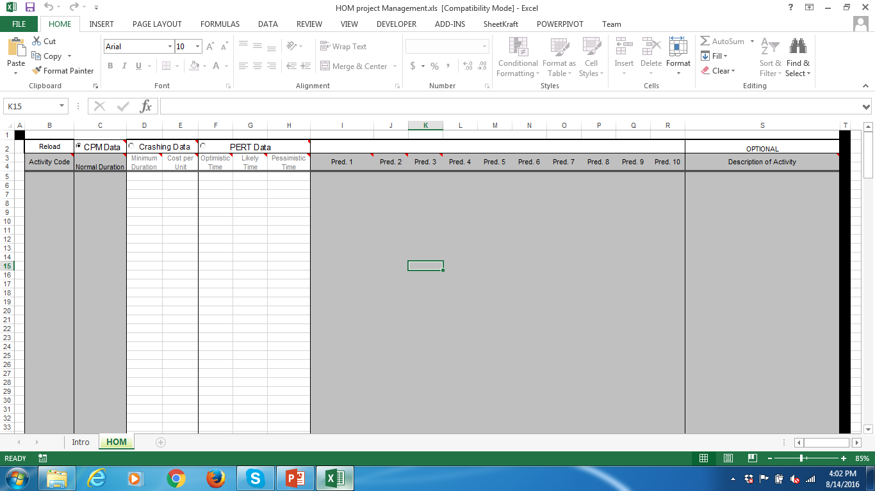
Working in the HOM application

Slide 6
Introduction to HOM - Project Management module
To run the HOM – Project Management module, select HOM module from the Add-Ins option and, select Project Management Module.
This will take you to a screen which allows you to determine which data you wish to analyze. More information is given on this in the next few steps.

Slide 7
The HOM Project Management Schema

Slide 8
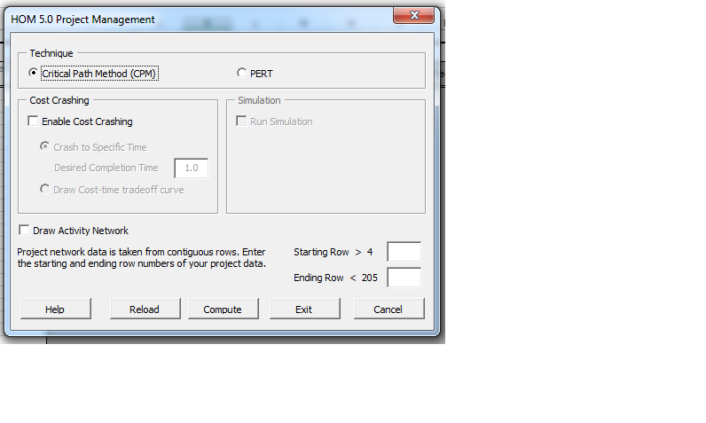
Parameters Dialog Box
HOM module allows the user to specify the settings in the Parameters dialog box. A sample parameters dialog box is given below.

Slide 9
Parameters Dialog Box
Select Data
The user can either load data from reloadable examples or insert their own data using the method described below
Reload Datasets:
To reload saved reports please follow the steps below:
Open ‘HOM Project’ from the HOM menu.
Click the reload button which will ask the user to select Report file (.csv) which the user wishes to open.
Select the file and click ‘Open’, this will reload all the parameters for computing.

Slide 10
Project Management - Steps
Step I: Choose technique
Specify which type of problem is being solved select one of radio buttons from CPM data or Crashing data or PERT data
Step II: Select Data (Parameters Box)
Input the starting and ending row of the data (between row 4 to 205)
or
Reload Datasets
Open ‘HOM Project Management Module’ from HOM menu
Click the reload button which ill ask the user to select Report file(.csv) which the user wishes to open
Select the file and click ‘Open’ this will reload all the parameters from computing
Click ‘Compute’ to reload the result sheets

Slide 11
Project Management - Steps
Step III: Draw Activity Network (Parameters Box)
Check the Draw Activity Network button to see a drawing of the network of activities. This can be done under both CPM and PERT.
Step IV: Run Model (How to Manage Projects)
To run the model you have to click on the specified compute button. This will open up one or more worksheets with the data analysis and results

Slide 12
Project Management - Steps
Step V: Analyze and Save Results
Analyze Results
CPM
The CPM window contains the GANTT chart (both early and late start schedule can be plotted)
The next part of the result window shows critical path calculations
The next output item is the project completion time, and finally a list of those activities on the critical path

Slide 13
Project Management - Steps
Step VI: Analyze Results
Analyze Results
PERT
Two possible results based on simulation is selected or not
Without Simulation the result window shows Gantt Chart followed by PERT calculation
The total project expected completion time is given next followed by the standard deviation of the expected time on the critical path

Slide 14
Project Management - Steps
Step VII: Save Reports button
Single Save
To save report, user can click Save button followed by specifying the name of the report to be saved
Multiple Save
For multiple save, user can press ‘Ctrl + S’ or ‘Save ’ button from Menu followed by selecting the sheets which are not shaved.

Slide 15
Loading an example
To obtain the dialog box, select HOM module from the Add-Ins option on the tool bar.
This will open the Dialog box which allows you to select which method to use. Sample parameters Dialog box is given below.
Press Reload button on the dialog box to load an example. Example 1 can be found in the data file
Project_CPM_time.csv in the EXAMPLES directory.

Slide 16
Loading an example
Following is the screenshot of the same

Slide 17
Data Set Loaded
Reload | CPM data | Crashing Data |  | PERT Data
Activity Code | Normal Duration | Minimum Duration | Cost per Unit | Optimistic Time | Likely Time | Pessimistic Time | Pred. 1 | Pred. 2 | Pred. 3
move | 2 | 1 | 1000 | 2 | 2 | 2
rbo | 4 | 3 | 6000 | 4 | 4 | 4
frame1 | 3 | 2 | 5000 | 3 | 3 | 3 | rbo
wire1 | 6 | 4 | 5000 | 6 | 6 | 6 | frame1
instal | 1 | 0.6 | 5000 | 0.4 | 0.6 | 0.8 | wire1 | move
ckt-a | 2 | 1 | 7500 | 2 | 2 | 2 | instal
conn | 1 | 0.7 | 6667 | 1 | 1 | 1 | ckt-a
ckt-b | 2 | 1 | 7500 | 2 | 2 | 2 | conn
walk1 | 0.5 | 0.5 | 0 | 0.5 | 0.5 | 0.5 | ckt-b
touch1 | 1 | 0.7 | 5000 | 0.5 | 0.7 | 1 | walk1
online | 0 | 0 | 0 | 0 | 0 | 0 | touch1 | touch3
layout | 4 | 3 | 6000 | 1.5 | 3 | 4
frame3 | 4 | 2.5 | 4667 | 1.5 | 2.5 | 4 | layout
roof | 3 | 2 | 6000 | 1 | 2 | 3 | frame3
ext | 2 | 1 | 5000 | 2 | 2 | 2 | frame3
plumb | 5 | 3 | 4000 | 5 | 5 | 5 | roof | ext
wire3 | 6 | 4 | 5000 | 2 | 4 | 6 | roof | ext
hvac | 4 | 3 | 3000 | 4 | 4 | 4 | roof | ext
insul | 2 | 1.5 | 8000 | 2 | 2 | 2 | plumb | wire3 | hvac
int | 2 | 1.5 | 6000 | 1 | 1.5 | 2 | insul
paint | 1 | 0.7 | 10000 | 1 | 1 | 1 | int
fixt | 1 | 0.7 | 6667 | 1 | 1 | 1 | paint
carpet | 0.5 | 0.5 | 0 | 0.5 | 0.5 | 0.5 | fixt
walk3 | 0.5 | 0.5 | 0 | 0.5 | 0.5 | 0.5 | carpet
touch3 | 1 | 0.7 | 5000 | 0.5 | 0.7 | 1 | walk3
Home construction project!
CPM Selected
Each task can have upto 10 predecessors
Eg: Roof takes 3 units of time, predecessor is frame3
Can have up to 199 tasks
Must be entered in contiguous rows

Slide 18
General Instruction on entering data
Fill in Activity names under the ACTIVITIES column. Names can be numbers, letters or short abbreviations. A more complete definition can be given for each activity, if desired, by moving the cursor to the extreme right of the spreadsheet to the optional activity DESCRIPTION column. Up to 199 activities can be specified .
Enter up to ten immediate predecessors for each task. If a task has only one immediate predecessor, enter it in column PRED 1. If it has two, use columns PRED 1 and PRED 2, and so on. The name used to identify the predecessor must be identical to its short activity name. A task without predecessors (i.e., starting tasks) will have no predecessors listed in its appropriate row.
If you plan to use CPM analysis, select CPM DATA and fill in the duration of each activity in the row corresponding to the activity under the column NORMAL DURATION. If you plan to use Crashing select CRASHING DATA. Then fill in the minimum duration that the activity can be crashed to under the appropriate column. If the minimum duration differs from the normal duration fill in the cost of crashing by one unit of time under the column COST PER UNIT.
If you plan to use PERT analysis, select PERT DATA. Fill in the Optimistic, Likely and Pessimistic times under the appropriate columns.
NOTE: Be sure to select the correct radio button(CPM data or Crashing data or PERT data) so that HOM will allow you to input the data you need.
Warning! Any data in sheet other than HOM sheet will be automatically deleted on exit. Output can be saved using the Save option. See Step VII

Slide 19
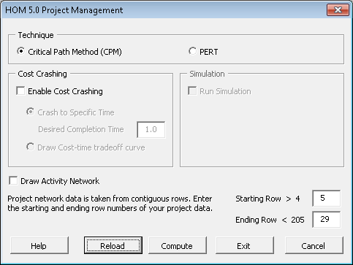
Dialog Box Choices
CPM selected
Start Row
End Row
Data must be in contiguous row
If draw network selected will represent data as a network

Slide 20
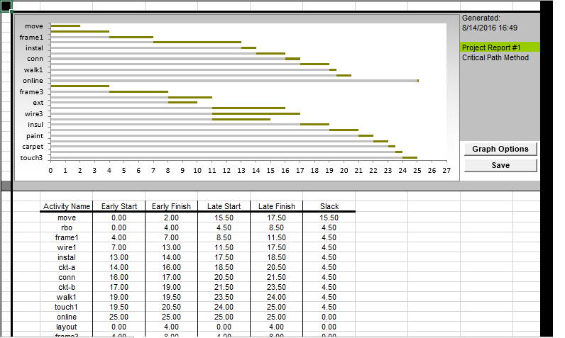
Output for Example (on pressing compute)
Gantt chart shows the earliest each task can be started and completed.
Table gives Early as well as late start (latest task can start without delaying the project.
Slack shows how much delay can be tolerated in the task w/o affecting project completion

Slide 21
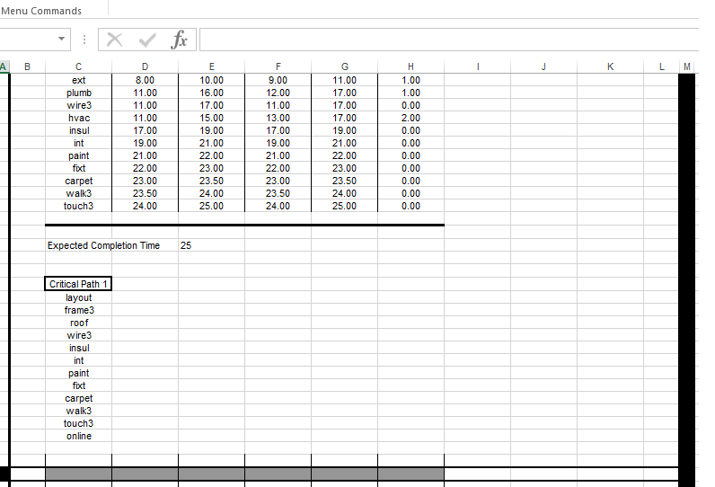
Output for Example
List of activities on critical path
Tasks that are critical have zero slack.
The longest path is called the critical path.

Slide 22
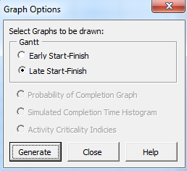
Early vs Late Start Gantt Chart
Under graph options choose to visualize both schedules

Slide 23
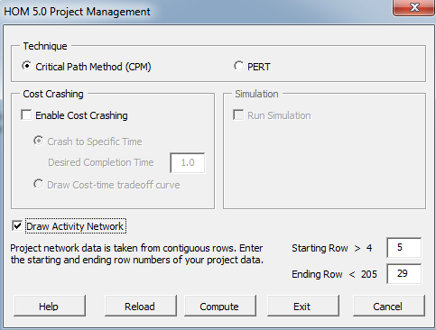
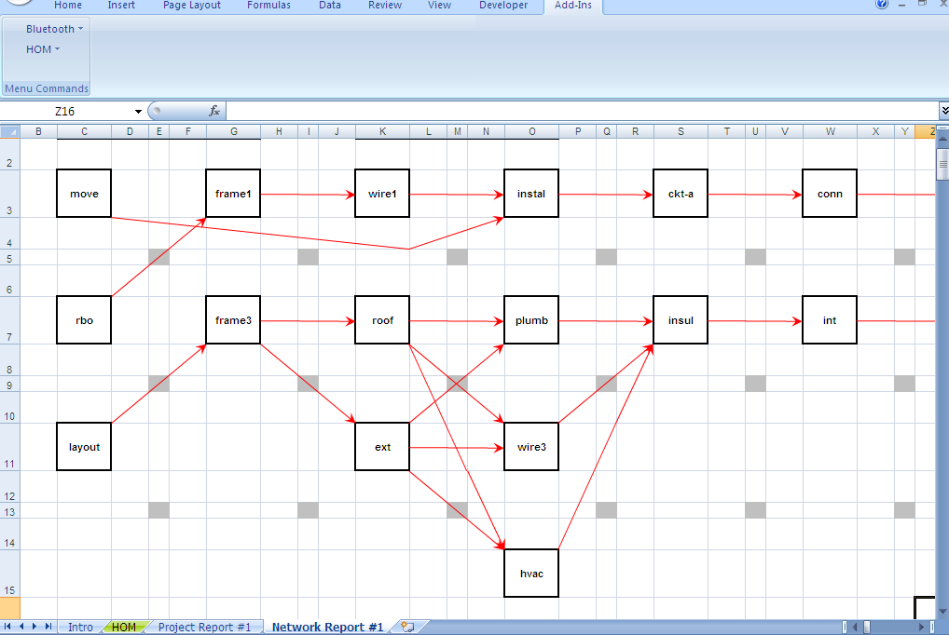
Drawing the project network
HOM can draw the network given the project data.

Slide 24
CPM Crash
Minimum Duration: This is the minimum duration to which the activity can be crashed.
Cost/Time: The cost of reducing the duration of an activity (crashing) by a unit of time.
Activity Duration: This is the normal duration of the activity

Slide 25
CPM and Crashing
Crashing the duration (reducing the duration) of an
activity increases the activity cost but may reduce the duration of the project. The latter has several project level benefits, such as:
Direct benefits
Indirect benefits
The objective is to trade-off these overall benefits against the cost of crashing activities

Slide 26
Example of crashing
Overtime
Mechanization of work (crane or forklift)
Extra resources (labor, machines)
Faster logistics (air vs truck)
Not to be confused by parallelization or activity reversal

Slide 27
CPM Crash Setting
In the dialog box choose Enable Cost Crashing. The data entry part for cost data will change in color to indicate editing is enabled.
There are two options:
Determine the entire cost-time trade-off curve. This will compute the cost-time trade off from the normal to the minimum possible duration.
Determine the optimal cost of reducing the project duration to a given value. Here, the user enters a value. If that value is infeasible, the program returns a message stating so.
Examine the cost time trade-off data entered. You will notice some activities can not be reduced in duration. In that case set minimum duration = normal duration and crash cost = 0.

Slide 28
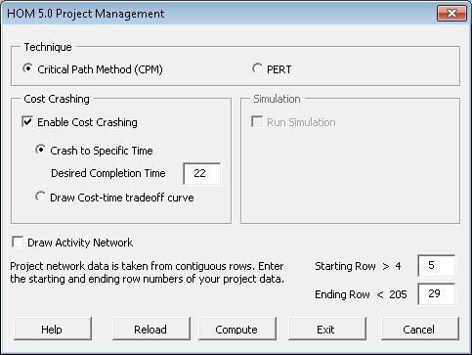
CPM Crash Dialog Box
We know the project can be completed in 25 days. Try to reduce it to 22 days.

Slide 29
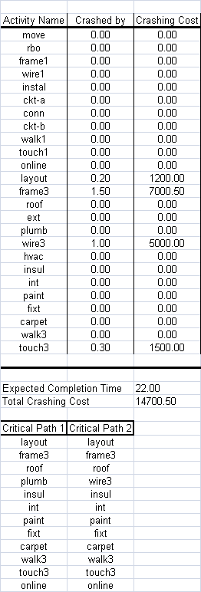
CPM Crash Output
Layout, frame3, wire3, touch3 are crashed.
Now there are two critical paths!

Slide 30
Technical aside
Linear Program: When the calculations start, the given data are first converted into a linear program. The conversion method is outlined in Eppen, Gould and Schmidt, (1993). Then the resulting LP is solved by a standard two-phase simplex method.
If the task durations need to be integral then the problem becomes an integer program. Other interesting restrictions, including resource restrictions can be modeled (not in this version!).
For example (not in this version).
One can model constraints such as concrete mixing can start soon as foundation 1 or foundation 2 is complete.
Either the crane and loader must be free or else the crane and two dumpers are necessary.
In general, rule based constraint programming is possible.

Slide 31
Introduction to PERT
B
C
A
D
G
H
E
F
There is considerable uncertainty in task durations!

Slide 32
Introduction to PERT
ACTIVITY DURATIONS
MIN LIKELY MAX MEAN S.D.
---------------------------------------------------------------------------------------------------
A-B 2 5 8 5.00 1
A-D 4 5 7 5.17 0.5
A-E 6 8 12 8.33 2.0
B-C 1 3 7 3.33 1.0
C-G 2 4 5 3.83 0.5
D-G 8 9 11 9.17 0.5
E-F 4 5 7 5.17 0.5
F-G 6 8 10 8.00 0.67
G-H 1 2 3 2.00 0.33
----------------------------------------------------------------------------------------------------
MEAN = (MIN + 4*LIKELY + MAX)/6 due to beta distribution assumption.
STANDARD DEVIATION (S.D.) = (MAX - MIN)/6
Why 3 time
estimates?
How estimated?
Other options?
PERT….

Slide 33
Why three time durations?
PERT….
Managers are able to estimate pessimistic, likely and optimistic times rather than mean and standard deviation.
Likely corresponds to the mode of the distribution.
Exact distribution can be used if available (not in this version).
The three time estimates are converted to the mean and standard deviation of the task duration
MEAN = (MIN + 4*LIKELY + MAX)/6 due to beta distribution assumption.
STANDARD DEVIATION (S.D.) = (MAX - MIN)/6

Slide 34
Draw the network and find critical path
PERT….
(3.33,1)
B
C
(3.83,0.5)
(5,1)
(5.17,0.5)
(9.17,0.5)
(2,0.33)
A
D
G
H
(8.33,1)
(5.17,0.5)
(8,0.67)
E
F

Slide 35
Calculate the distribution of project completion time
PERT….

Slide 36
Normal Approximation
PERT….

Slide 37
Normal Approximation
PERT….
Project completion time has Normal Distribution with mean 23.5 months and standard deviation 1.344.
Standard Deviation = 1.344
Probability
Project Duration, T
Mean = 23.5
Probability Completion Time <= 25 days
Pr{ Z <= (25 – 23.5)/1.344} = Pr{Z <= 1.12}
What is the probability the project will take more than 26 days?

Slide 38
Loading (PERT) example (same one)
To obtain the dialog box, select HOM module from the Add-Ins option on the tool bar.
This will open the Dialog box which allows you to select which method to use. Sample parameters Dialog box is given below.
Press Reload button on the dialog box to load an example.
Project_PERT_Heuristic_New.csv in the EXAMPLES directory.
Look at the dialog box.

Slide 39
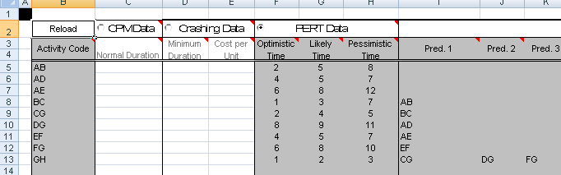
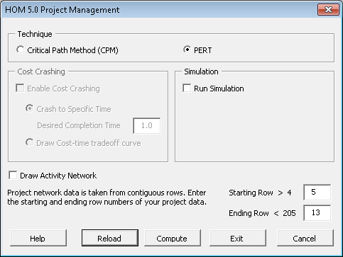
PERT Data and Dialog Box

Slide 40
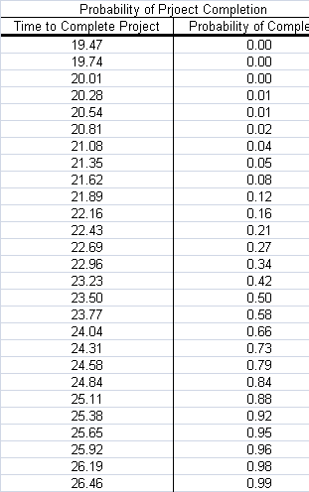
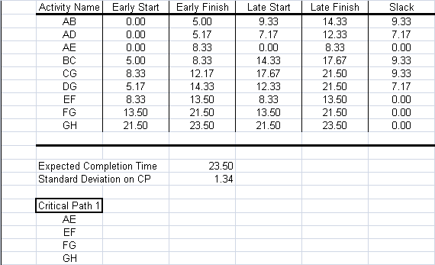
PERT Output

Slide 41
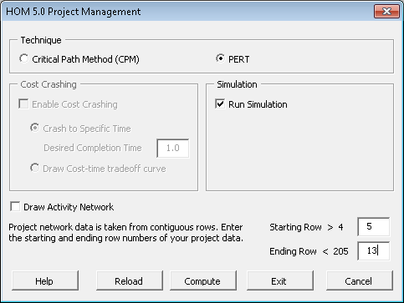
Simulation
Running a simulation gives more diagnostics!

Slide 42
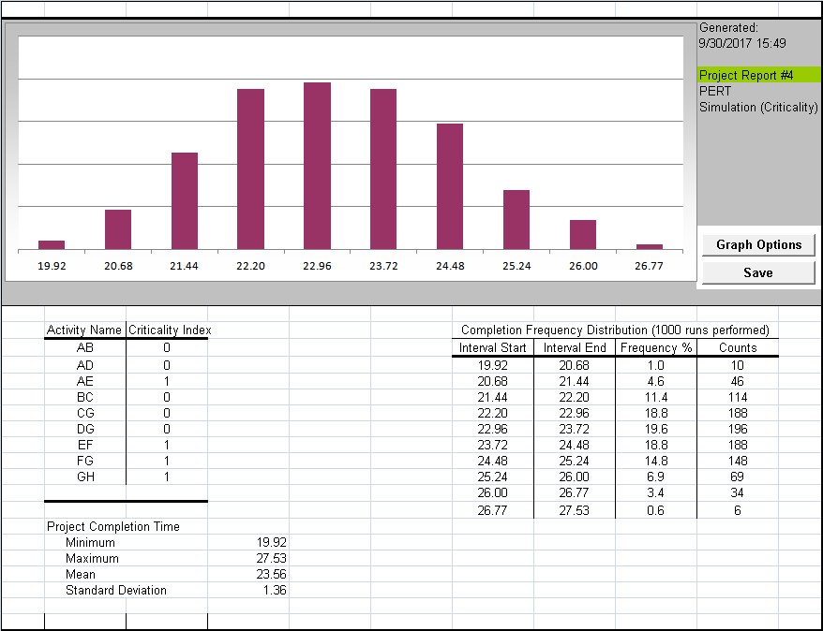
Simulation Output
Simulated distribution
Criticality Index: In what percentage of the simulations was the activity critical

Slide 43
More examples
Likewise, user can work on other examples. Following are the datasets provided with this module.
Project_CPM_time.csv
Project_CPM_Costtime_tradeoff.csv
Project_CPM_Costcrashing.csv
Project_PERT_Heuristic.csv
Project_PERT_Simulation.csv
Kindly refer to the manual and Tutorial for technical details and step-by-step procedure.

Slide 44
Tasks
Practice problems
Solve problems 1 (or 2)
Solve problems 9 and 10
Solve the Campus Wedding Case (A)

